Slide 1
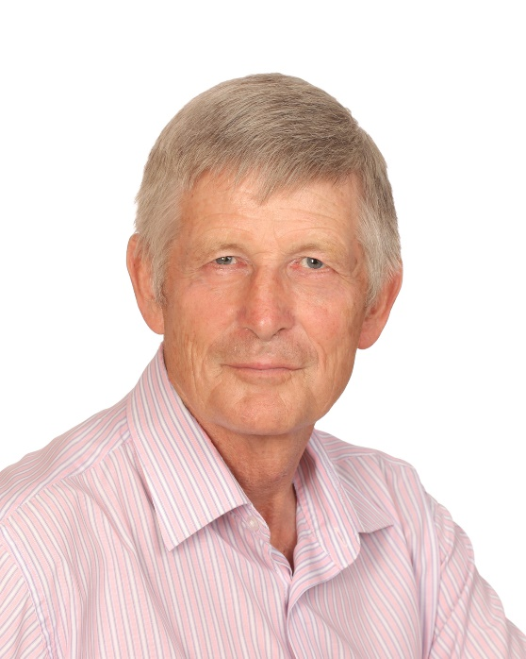
EIA: A Model to Facilitate Strategic Planning and Performance Management
Bryan Leach
Insert presenter headshot here.
CLICK & DELETE THIS TEXT BOX.
Independent Researcher/Consultant
Canada
bryleach@telusplanet.net

Slide 2
MODEL FRAMEWORK
PUBLIC CONSULTATION AND ENGAGEMENT
COLLABORATIVE
(MEANINGFUL)
RELATIONSHIPS
PROPONENTEMPATHY
STAKEHOLDERS
TRUST
GOVT./REG. APPROVAL
(SOCIAL LICENSE)
DECISION
MAKING
KNOWLEDGE
SHARING
IAIA 2022 Leach and Kerr

Slide 3
THE CONCEPTUAL MODEL
Interests/’Best Solution’
Reconciling (Two-way)
Consensus – Dialogue
Issues/Alternatives
Addressing (Two-way)
Public Consultation: Scope and Integration
Stakeholders’ Trust
(Competence + Communication + Contract + Capacity)
Consultative – Discussion
Impacts/Mitigation
Explaining (One-way)
Autocratic - Debate
Proponent’s Empathy
(Cognitive + Emotional + Compassionate + Radical)
IAIA 2022 Leach and Kerr

Slide 4
MODEL VALIDATION
IAIA 2022 Leach and Kerr

Slide 5
MODEL APPLICATION
IAIA 2022 Leach and Kerr

Slide 6
Bryan Leach
Independent Researcher/Consultant
Canada
bryleach@telusplanet.net

